Slide 1
证道 Sermon
讲员: Kirt 牧師
Speaker: Pastor Kirt

Slide 2
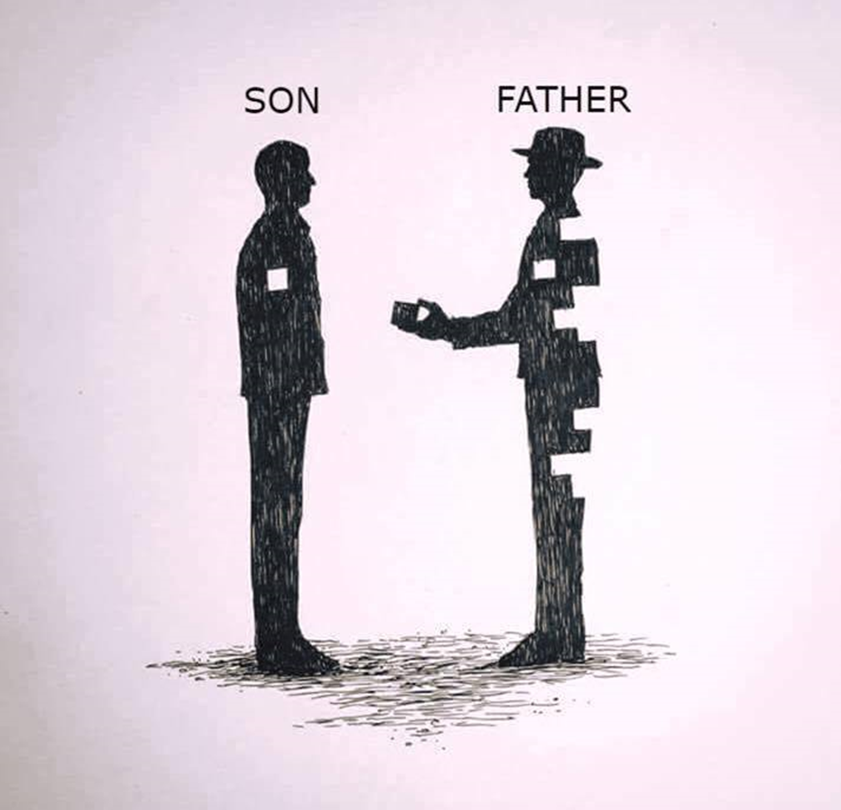
1 John 3:7-10 約翰一書 3:7-10
兒子
父親

Slide 3
藥物與手術
生活方式改變

Slide 4
兒子
父親

Slide 5
1 John 3:7-10. “ 7 Dear children, do not let anyone lead you astray. The one who does what is right is righteous, just as he is righteous. 8 The one who does what is sinful is of the devil, because the devil has been sinning from the beginning. The reason the Son of God appeared was to destroy the devil’s work. 9 No one who is born of God will continue to sin, because God’s seed remains in them; they cannot go on sinning, because they have been born of God. 10 This is how we know who the children of God are and who the children of the devil are: Anyone who does not do what is right is not God’s child, nor is anyone who does not love their brother and sister.”
約翰一書 3:7-10
7 小子們，不要被人誘惑，行義的才是義人，正如主是義的一樣。 8 犯罪的是屬魔鬼，因為魔鬼從起初就犯罪。神的兒子顯現出來，為要除滅魔鬼的作為。 9 凡從神生的，就不犯罪，因神的道存在他心裡；他也不能犯罪，因為他是由神生的。 10 從此就顯出誰是神的兒女，誰是魔鬼的兒女。凡不行義的，就不屬神；不愛弟兄的也是如此。

Slide 6
“What I do with my physical body on this physical earth reflects my heart for my Heavenly Father.”
1 John 3:7 Dear children, do not let anyone lead you astray. The one who does what is right is righteous, just as he is righteous.
“我在這物質世界裡對我的身體所做的一切，反映了我對天父的心。”
約翰一書 3:7 小子們，不要被人誘惑，行義的才是義人，正如主是義的一樣。

Slide 7
3: 8-10
If do “non-right acts”, or I am continually sinning, I am acting like the devil.
If I do “right acts”, or I am not continually sinning, I am acting like my Heavenly Father … and John says this person is a child of God.
3:8-10
如果我做『不義之事』，或是持續犯罪，我就是在效法魔鬼
如果我做『義之事』，或是不再持續犯罪，我就是在效法我的天父……而約翰說這樣的人是神的兒女。

Slide 8
1 John 3:8 The one who does what is sinful is of the devil, because the devil has been sinning from the beginning. The reason the Son of God appeared was to destroy the devil’s work.
約翰一書 3:8
犯罪的是屬魔鬼，因為魔鬼從起初就犯罪。神的兒子顯現出來，為要除滅魔鬼的作為

Slide 9
1 John 3:9 No one who is born of God will continue to sin, because God’s seed remains in them; they cannot go on sinning, because they have been born of God.
約翰一書 3:9
凡從神生的，就不犯罪，因神的道存在他心裡；他也不能犯罪，因為他是由神生的。

Slide 10
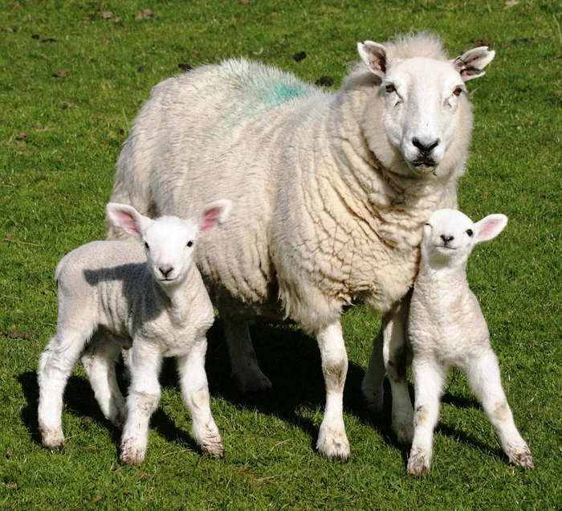
The Animal Sound Quiz.
a duck …____. A baby duck - ?
a dog …____, Wawa,
a cat …____, a baby cat …?
a pig …____, a baby pig…?
a sheep …____, a baby sheep …?
a cow ____, a baby cow …?
動物叫聲小測驗
一隻鴨子 … 一隻小鴨子 - ？
一隻狗 … Wawa
一隻貓 …一隻小貓 - ？
一隻豬 …一隻小豬 - ？
一隻羊 …一隻小羊 - ？
一隻牛 …一隻小牛 - ？

Slide 11
3:10 This is how we know who the children of God are and who the children of the devil are: Anyone who does not do what is right is not God’s child, nor is anyone who does not love their brother and sister.”
2 simple tests
Doing what is right
Loving others
3:10 從此就顯出誰是神的兒女，誰是魔鬼的兒女。凡不行義的，就不屬神；不愛弟兄的也是如此
兩個簡單的測試
做對的事
愛他人

Slide 12
Questions:
Do I do what is right according to God, according to God’s word (bible)?
Do I love my brother and sister according to God, according to God’s word?
問題:
我是否按照神的旨意、根據神的話語（聖經）做對的事？
我是否按照神的旨意、根據神的話語愛我的弟兄姐妹？

Slide 13
Summary - “What I do with my physical body on this physical earth reflects my heart for my Heavenly Father so Honor God by doing what is right.”
總結
我在這物質世界裡對我的身體所做的一切，反映了我對天父的心，
因此，我藉著做對的事來尊榮神。

